Slide 1
Data Analysis Using Tableau
Bank Customer’s Churn Data
By : Bhuwan

Slide 2
OVERVIEW
A certain bank in North America wants to perform customer churn data analysis, as the credit card business of the bank is not performing well.
Churn Data analysis will help bank to analyze the data of those customers who have stopped using the bank’s credit card.
Understanding, manipulating, interpreting and analyzing data to figure out measure to reduce customer loss of the bank.

Slide 3
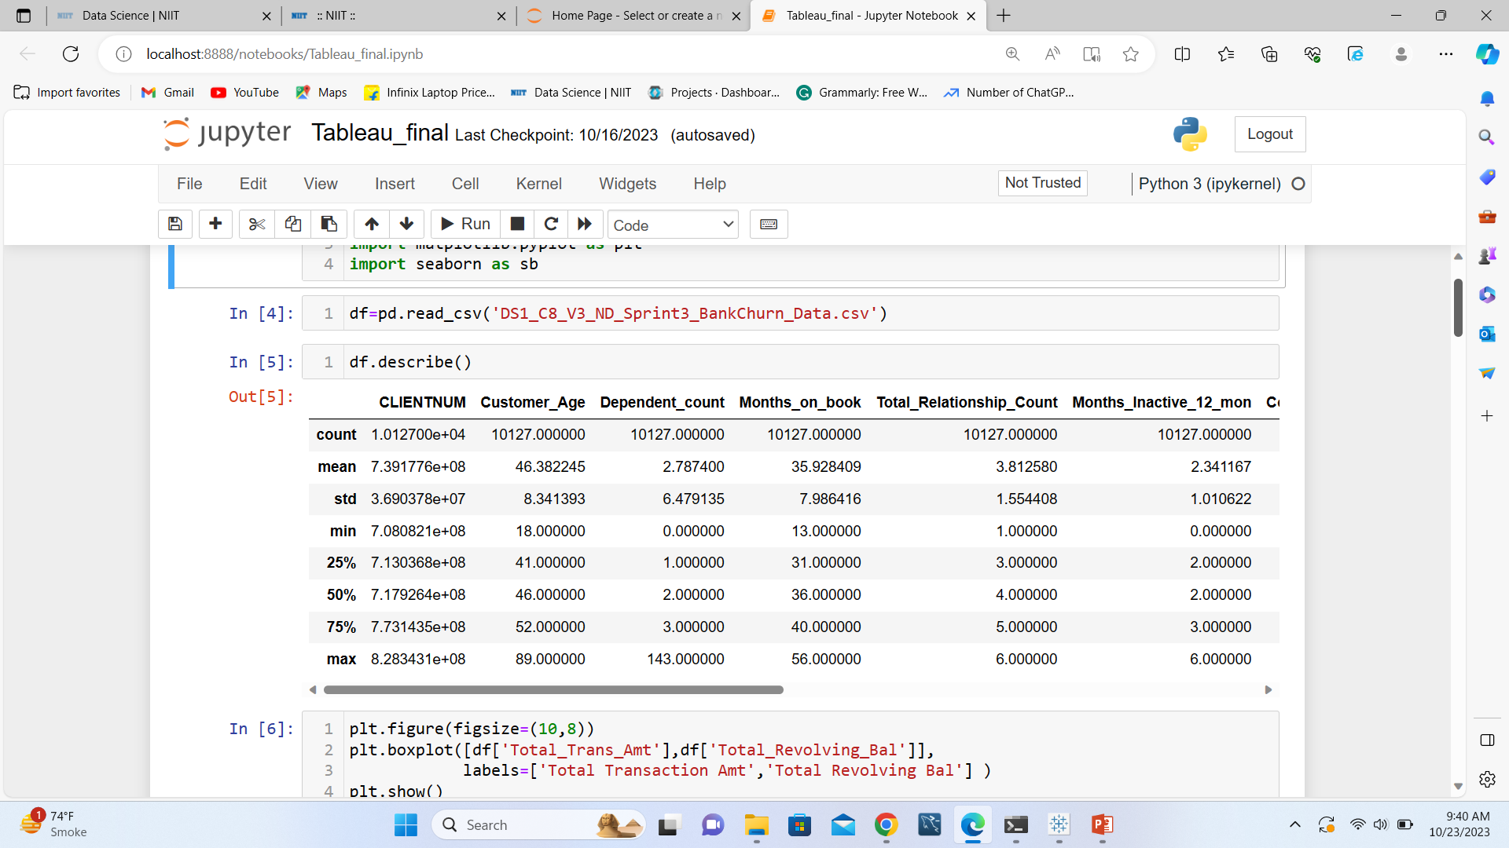
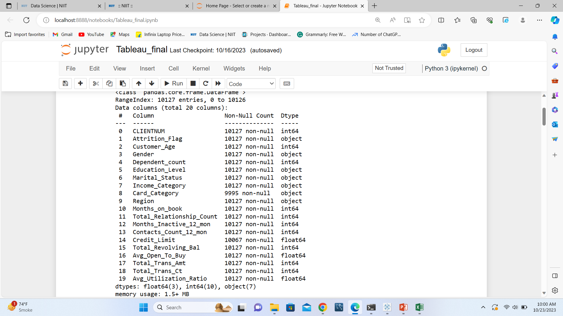
Identifying the Outliers
There could be outliers in multiple columns.
We are taking Total Transaction Amount, Total Revolving Balance and Dependent count to Identify the outliers.
And only taking action on Dependent count to remove the outlier as it has most outliers and it is not common to have that much number of dependent count of a person.

Slide 4
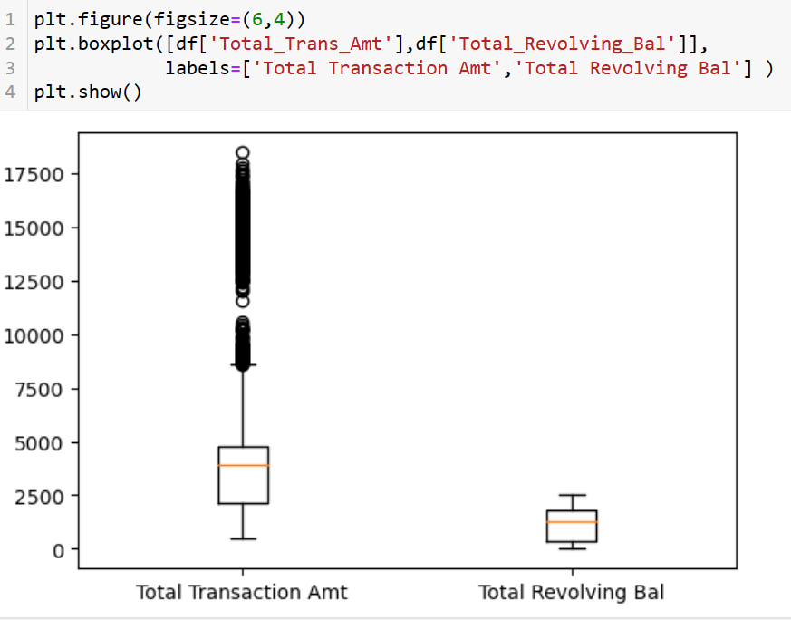
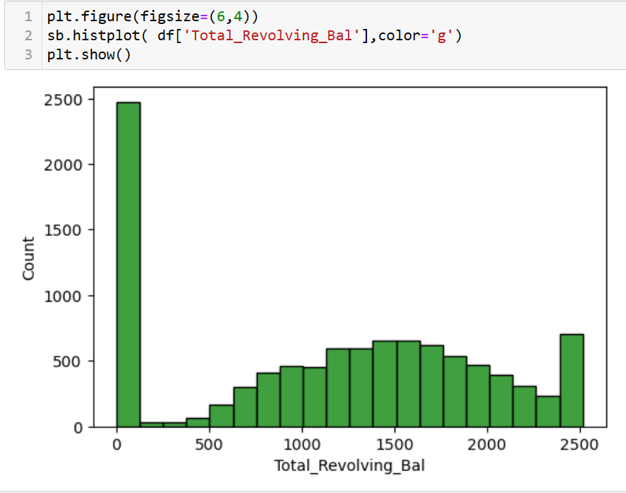
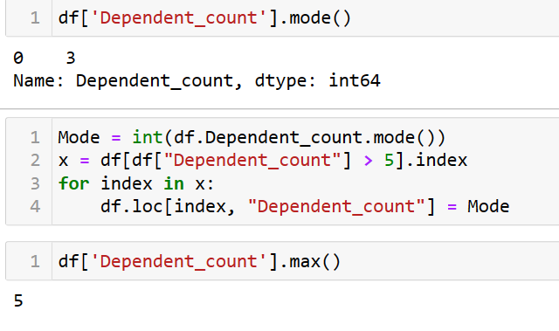
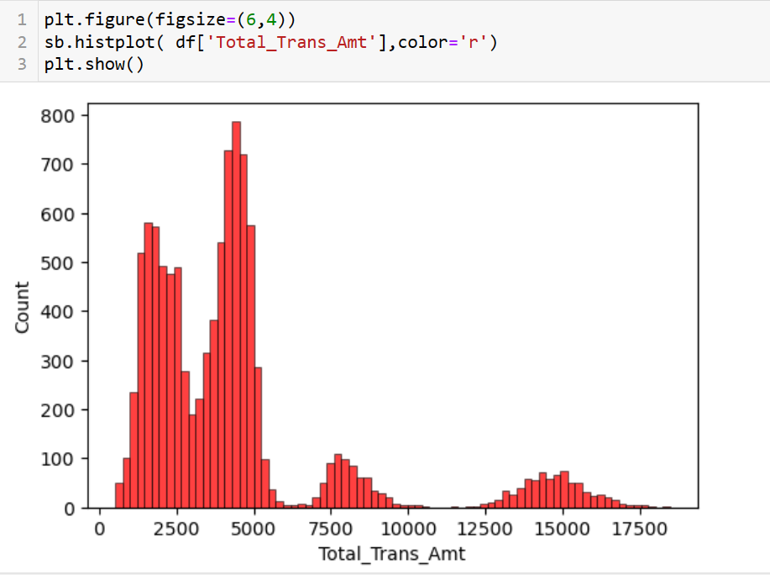
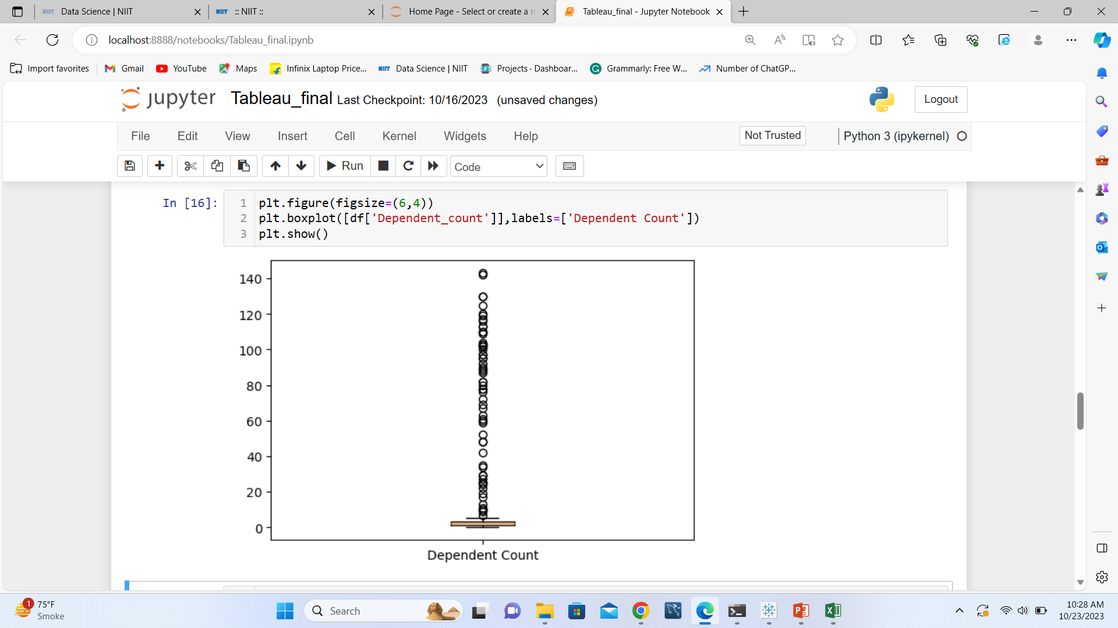
Identifying the outliers and imputing values
Dependent count and Total Transaction amount has most uneven distribution and most outlier.
Total revolving balance is more normal distributed, count of 0 values is quite high but still no outliers.
Imputing Mode value in Dependent count to remove the outliers and making the maximum count up to 5, which is much of reasonable value for dependent count of a customer.

Slide 5
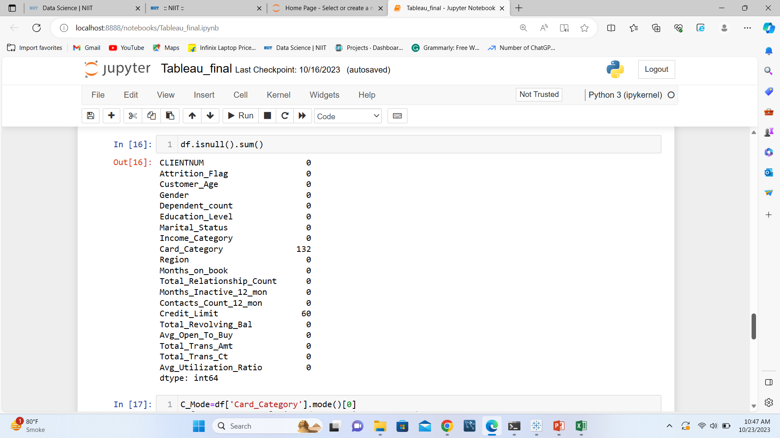
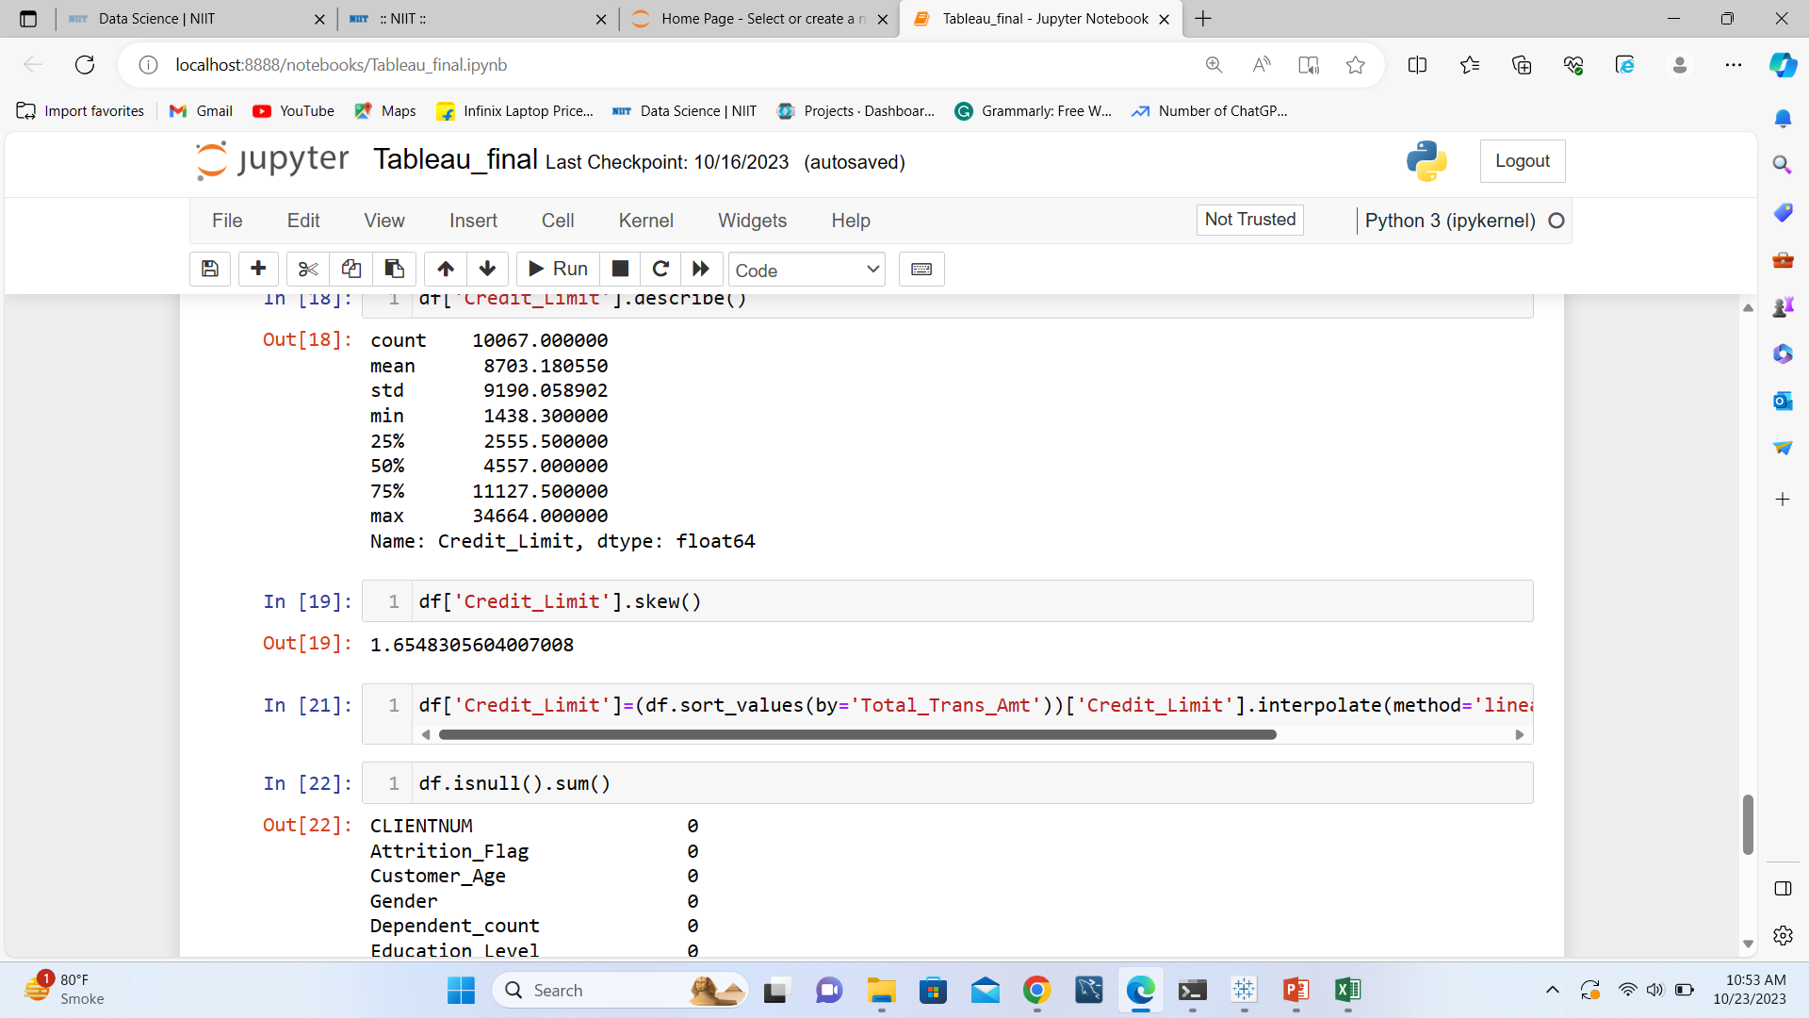
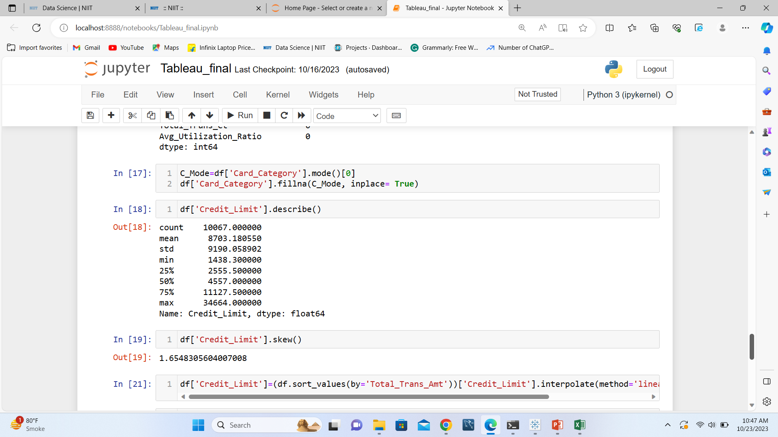
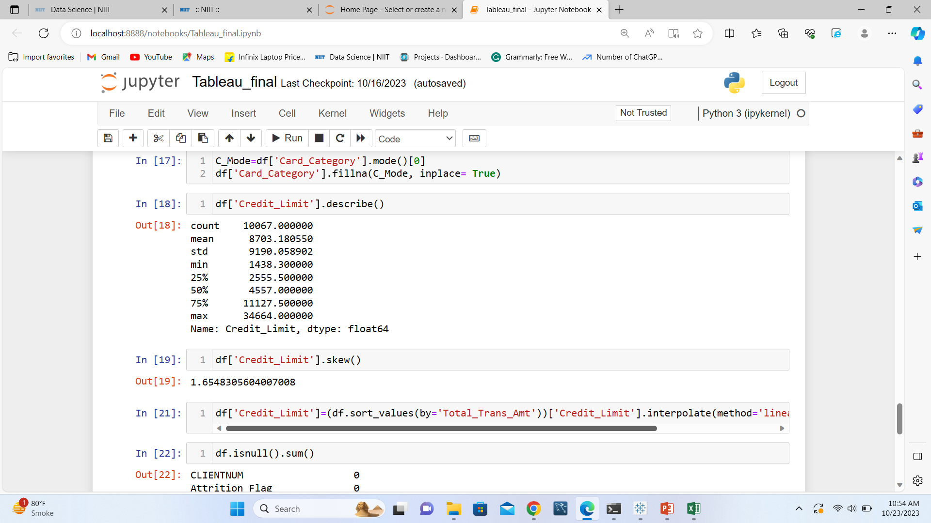
Identifying the missing values and imputing the data
There are only 2 columns with null values. As card category is categorical data, mode is better option to impute in the null values. Credit limit is highly skewed with quite high standard deviation and skewness as well. After sorting the data by total transaction amount and using Interpolation method to impute data, which seems to be better option than any other imputation method.

Slide 6
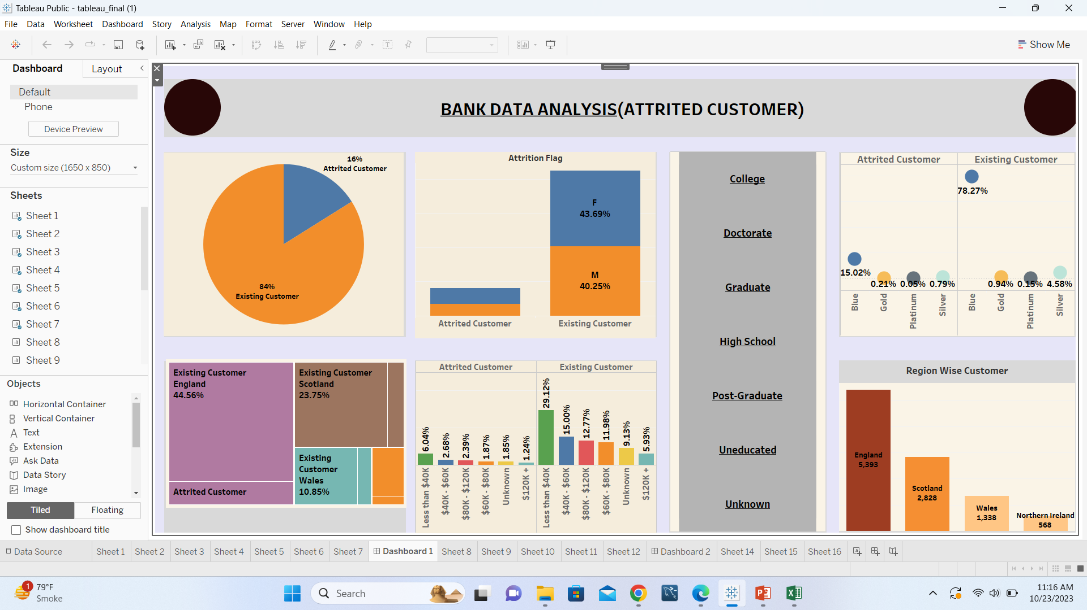

Slide 7
UNDERSTANDING THE VISULALS
Dataset contains data of 84% of existing customers and rest 16% of lost customers.
% of Females in both existing and attrited customers is more than Men.
Most number of existing(44.56%) and attrited(8.69%) customers are from England and the least from Northern Ireland.
Most number of existing and attrited customers are of Blue Card Category and the least are of Platinum card Category.
Customer having income less than $40K have most attrited as well as existing customer and customer with more than $120K+ with least.
England(5393) have most number of customers, followed by Scotland and the least customers are from Northern Ireland.

Slide 8
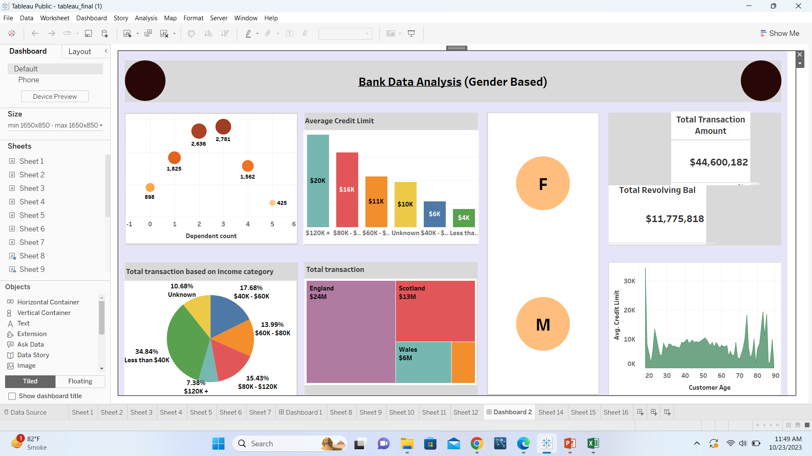

Slide 9
CONCLUSION
Bank need to give more offers which would attract more number of women as most number of customers are female
Least number of Attrited customer are from Northern Ireland, bank could coordinate with Northern Ireland branch of having better records than other regions.
Bank need to focus more on Blue Card Category customers as most of the customers belong to Blue card category and most attrited customers are also from Blue card Category.
Most of Bank’s customers having income less than $40K, bank can provide some offers to attract people with lower income level as they are most in number and most in lost customers as well.

